Slide 1
Facial Recognition With Support Vector Machine
James Mortensen

Slide 2
Introduction
Mid 20th Century as field of computer science grew in popularity
Applications:
Law Enforcement
User Authentication
Personalized Marketing
Healthcare
Popularity and Evolution
Data Availability
Algorithmic Advancements
Machine Learning vs Traditional Techniques
Notes:
Security and Law Enforcement: It aids authorities in criminal investigations, airport security checks, and border control.
User Authentication: It provides a secure way for users to unlock devices or access restricted areas.
Personalized Marketing: Businesses use this technology to offer customized experiences to customers by recognizing their preferences.
Healthcare: Medical professionals are exploring facial recognition for patient identification and even potential diagnostic applications.
Data Availability: The proliferation of large, publicly available datasets has enabled researchers to train more complex models. In the case of this research, we have the Labeled Faces in the Wild dataset. A publicly available and easily obtainable dataset of labeled images of faces.
Algorithm Advancements: The shift from traditional image processing techniques to deep learning has revolutionized the field. Neural networks have been instrumental in automating feature extraction, contributing to the significant improvement in accuracy and efficiency [3].

Slide 3
Scope and Goals
Identify a face out of a group of faces
Testing the following and Quantify Impact:
Impact of Data Composition (percentage of “you” vs “not you”
Face Detection Usage
SMOTE Resampling Usage
Design a system to carry out the tests above
Algorithm Selection
Algorithm optimization
Data Handling
Training and Evaluation
Notes:
SMOTE (synthetic minority oversampling technique) is one of the most commonly used oversampling methods to solve the imbalance problem. It aims to balance class distribution by randomly increasing minority class examples by replicating them.

Slide 4
Out of Scope
Comparing Algorithms
e.g. SVM vs CNN
Implementations beyond comparative testing
e.g Using a phone camera to verify access
Notes:
trained and tested model will not be used for implementations beyond classifying the performance of the model. For example, face verification using a phone camera. This research is targeted at testing the model alone.

Slide 5
Previous Work
[4] M. Turk and A. Pentland, “Eigenfaces for recognition,” Journal of Cognitive Neuroscience, vol. 3, no. 1, pp. 71-86, Jan. 1991, doi: 10.1162/jocn.1991.3.1.71.
Early facial recognition techniques for reducing dimensionality
[2] F. Schroff, D. Kalenichenko and J. Philbin, “FaceNet: A unified embedding for face recognition and clustering,” in Proceedings of the IEEE Conference on Computer Vision and Pattern Recognition, pp. 815-823, 2015.
Deep learning techniques for facial recognition and clustering
Notes:
Eigenfaces (Turk and Pentland): The Eigenfaces method introduced a way to represent faces using principal component analysis (PCA). By capturing the variance between facial images and representing them with a set of principal components or eigenfaces, this method allowed for efficient recognition. However, it struggled with variations in lighting and pose [4].
FaceNet (Schroff et al.): FaceNet extended facial recognition by directly learning a mapping from face images to a compact Euclidean space. Using a triplet loss function, FaceNet ensured that similar faces were closer in the embedded space, achieving impressive results on various benchmarks [2].

Slide 6
Experiment Design Overview
Data Collection
75 images of myself mixed in with Labeled Faces in the Wild at different weights
Data management
Face Detection
Face Recognition
Reporting and Report Refinement

Slide 7
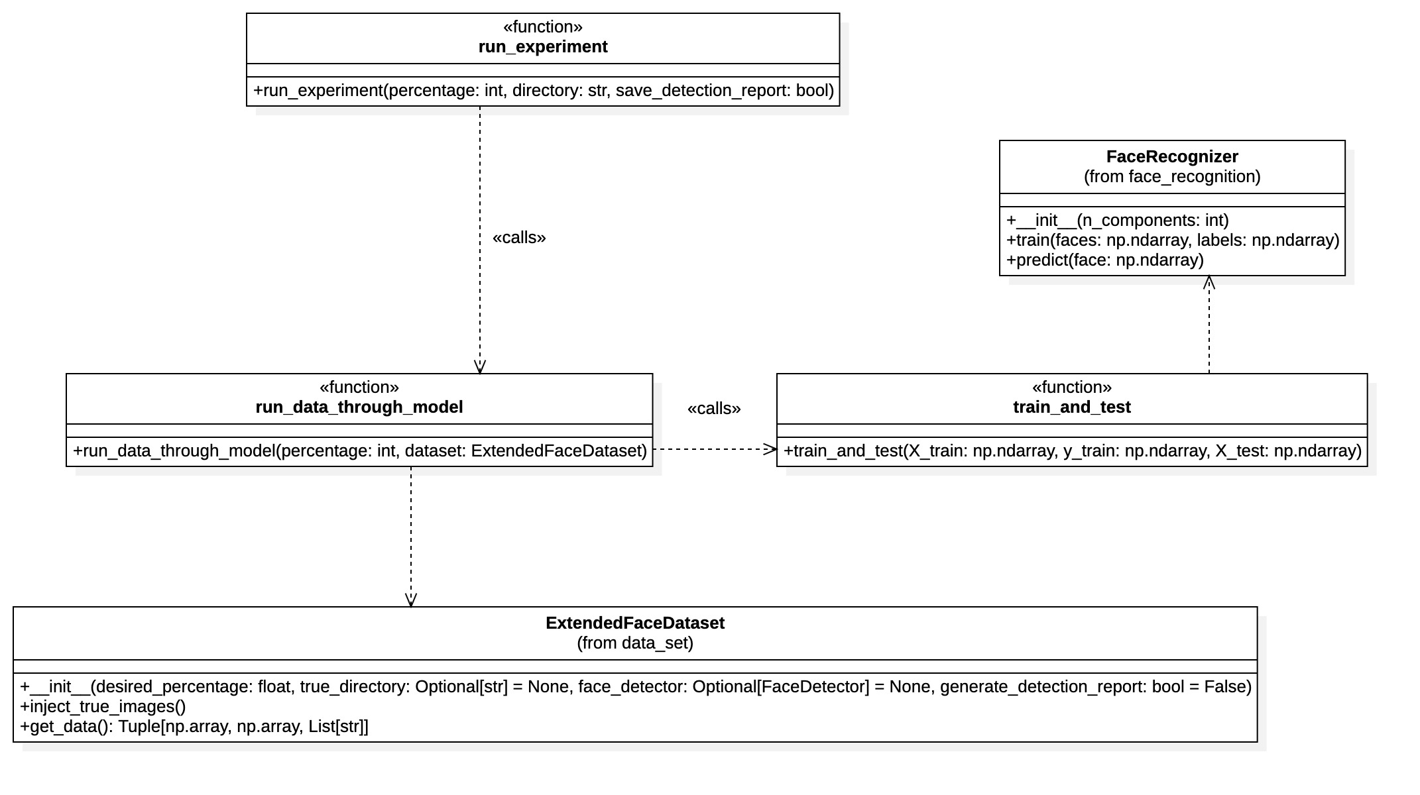
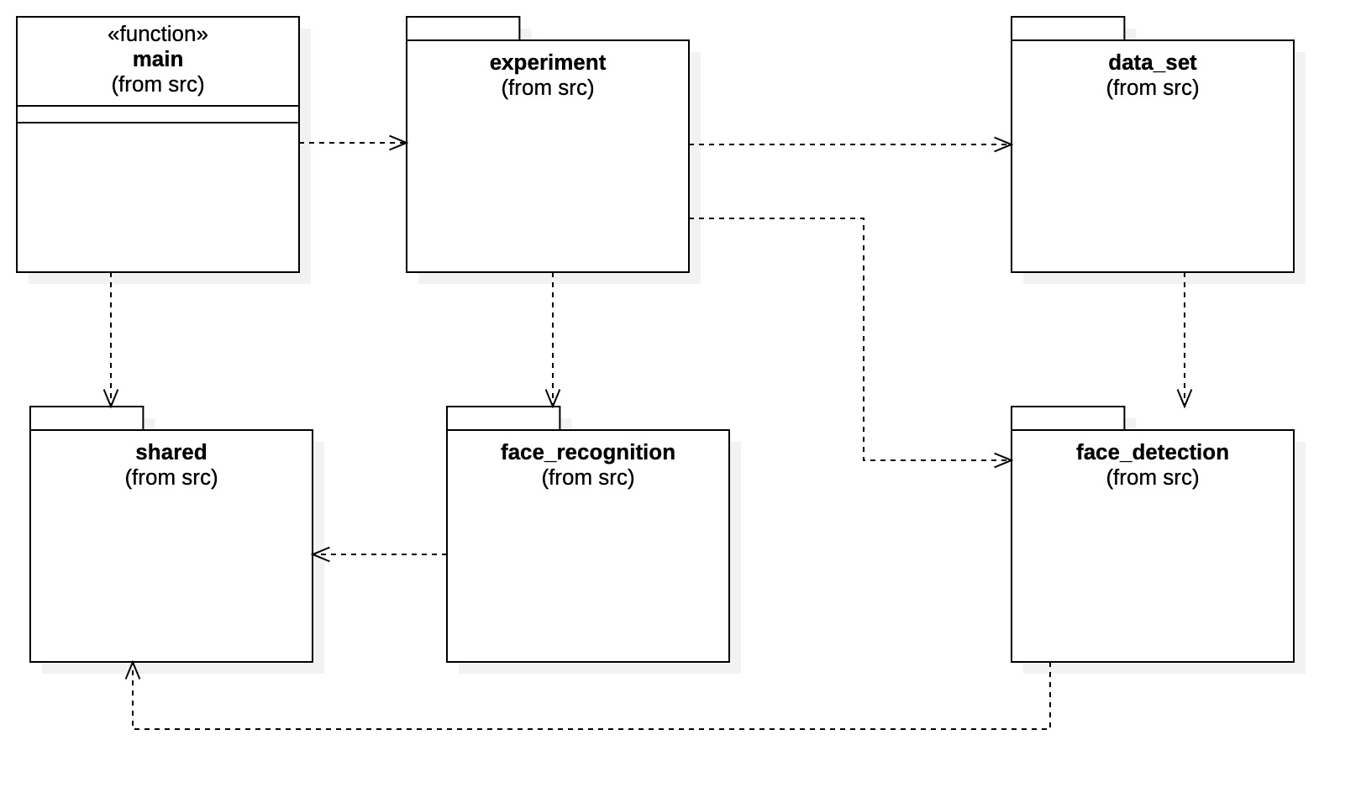
Experiment Design (structure)

Slide 8
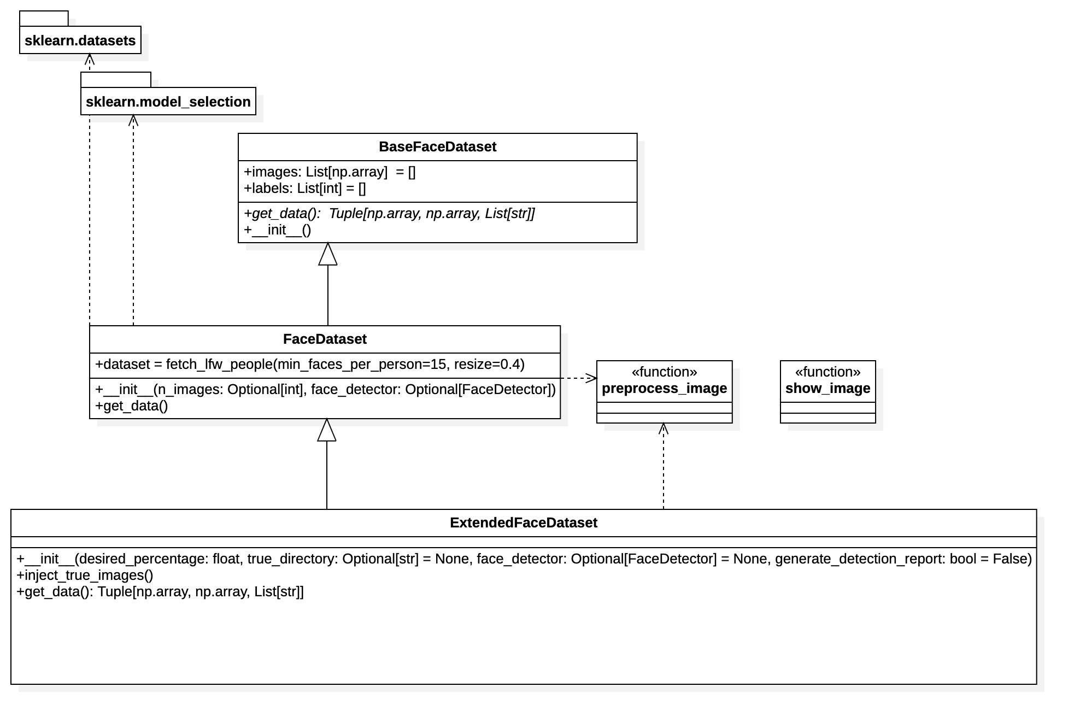
Experiment Design (structure)

Slide 9
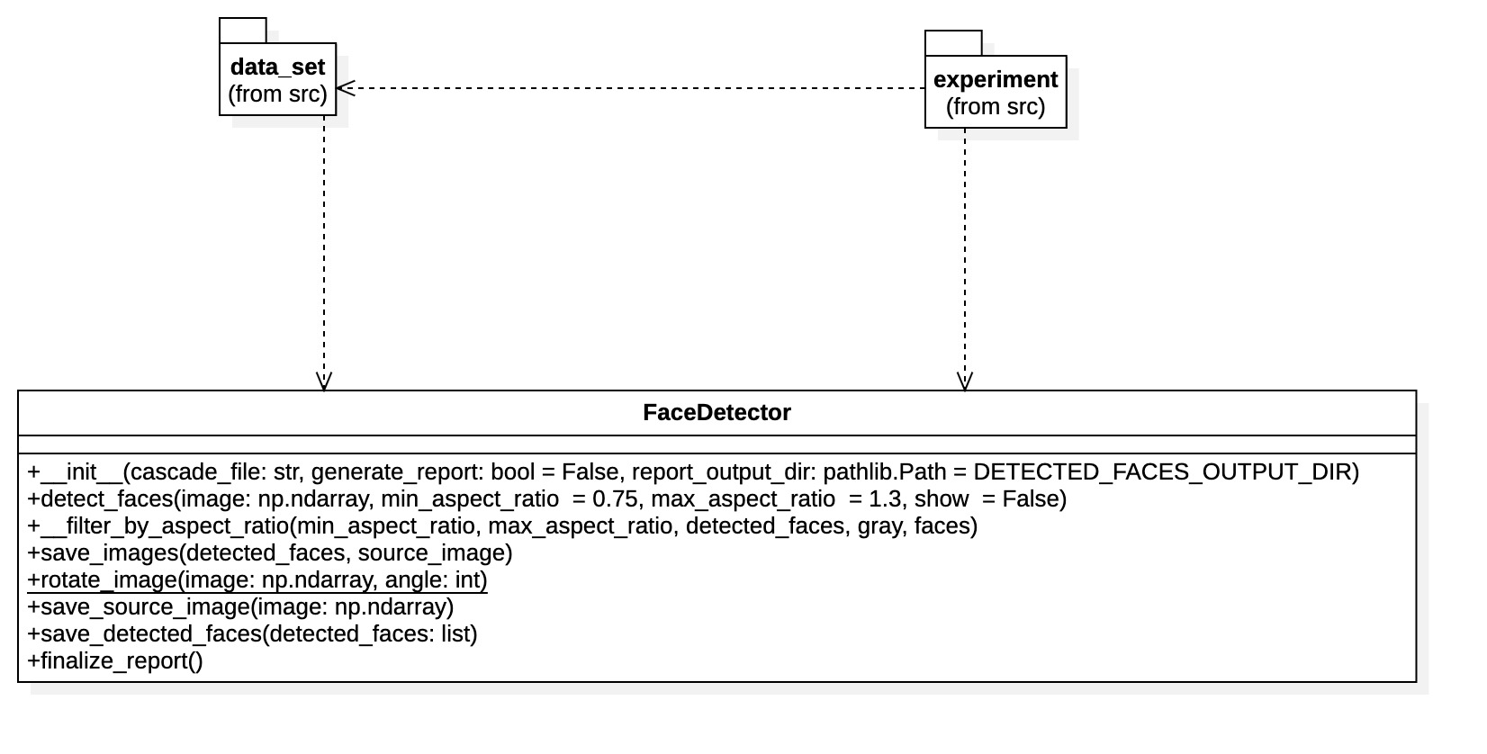
Experiment Design (structure)

Slide 10
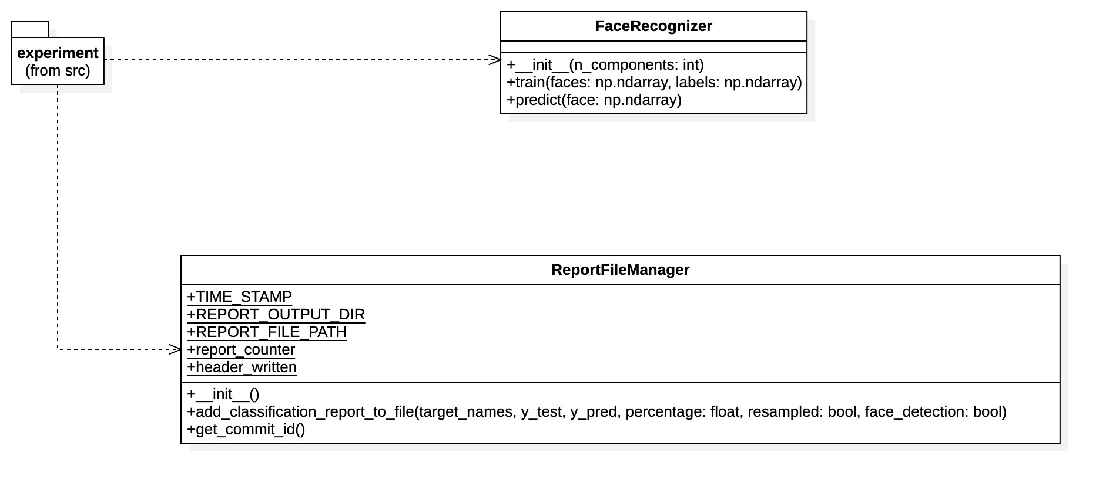
Experiment Design (structure)

Slide 11
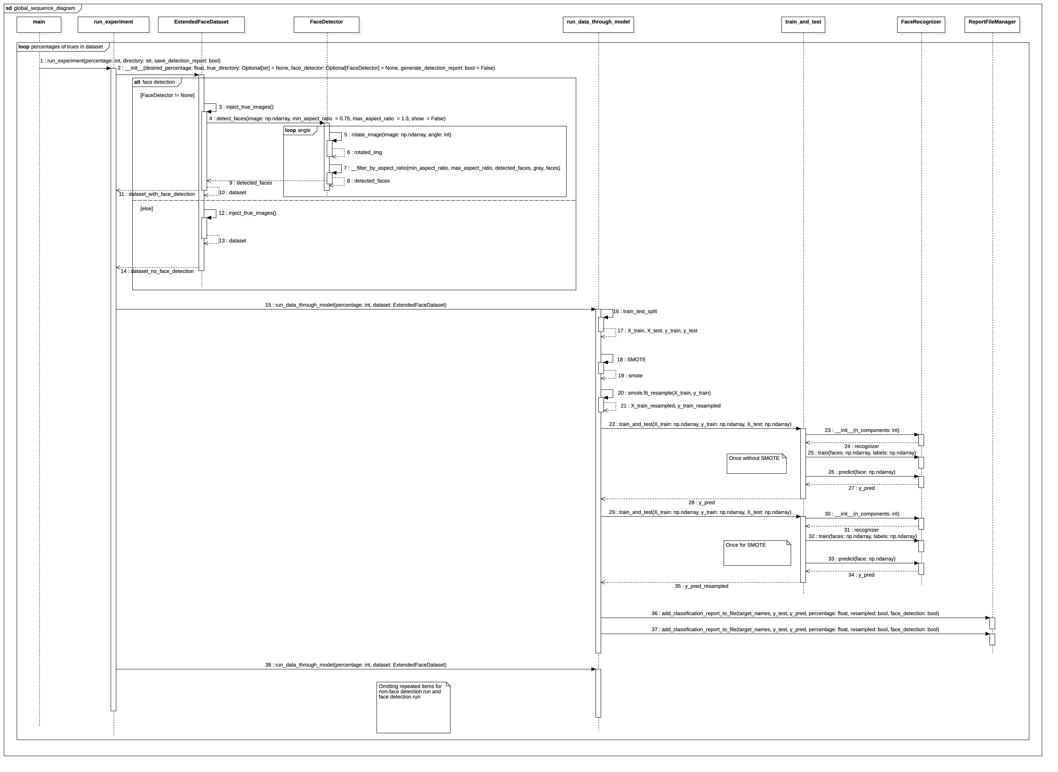

Slide 12
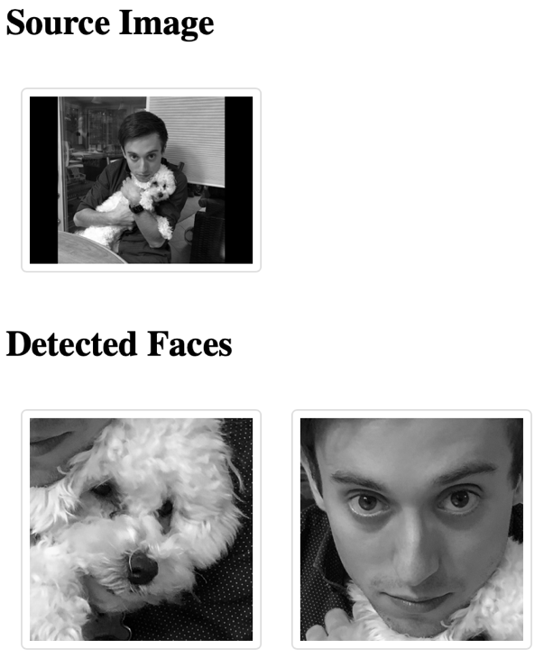
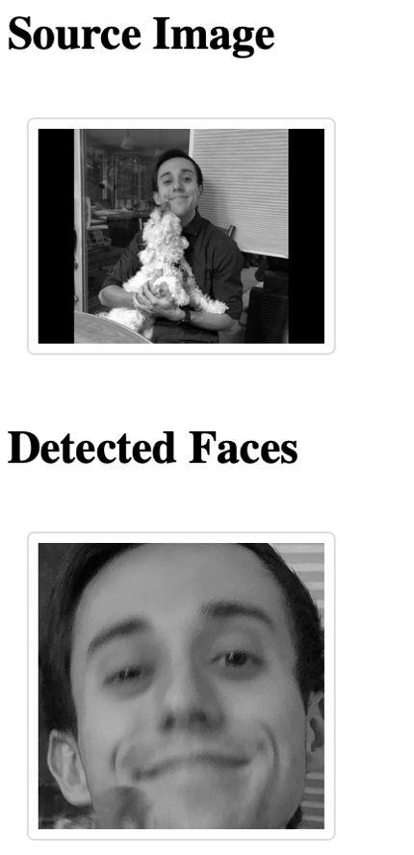
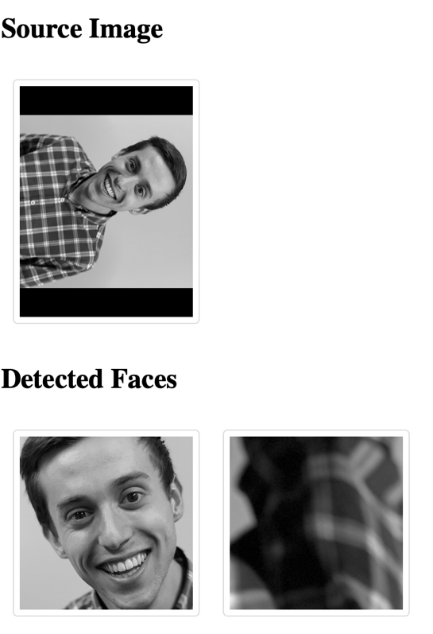
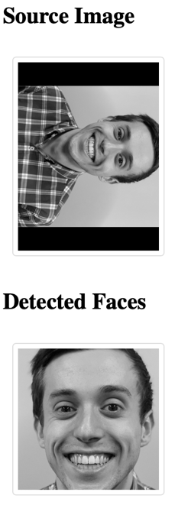
Results (Face Detection)

Slide 13
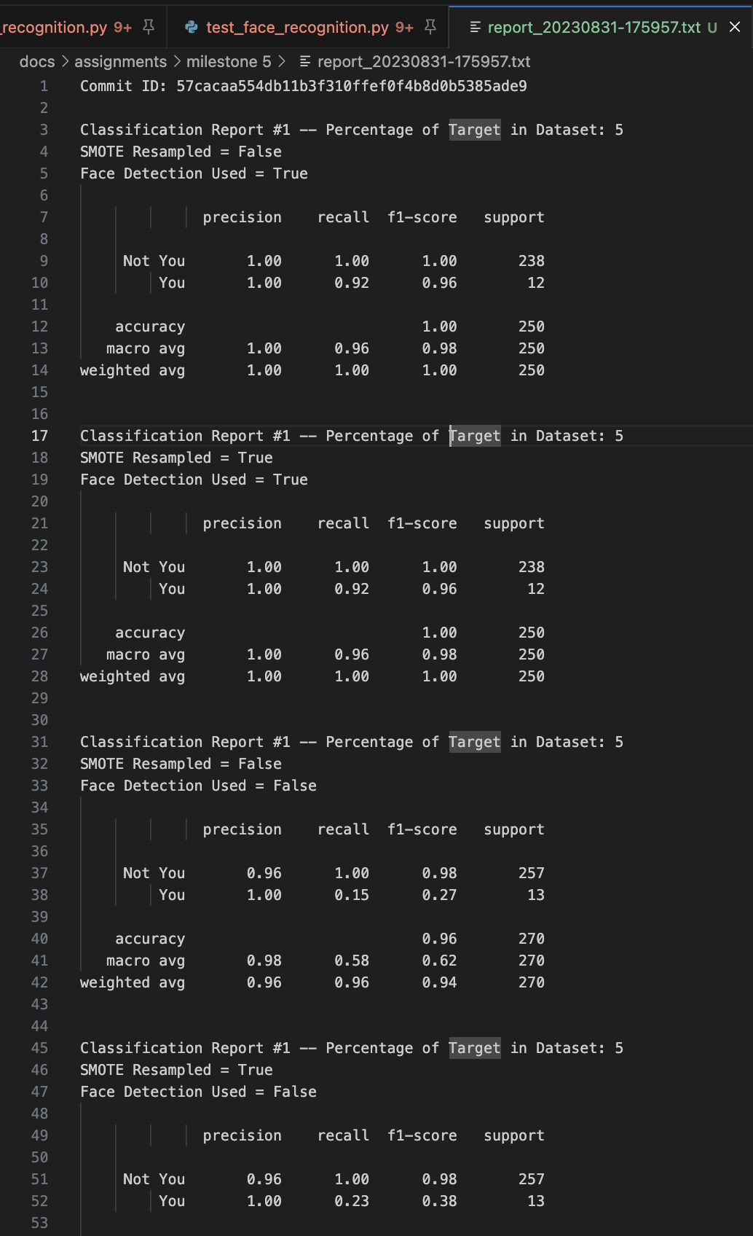
Results (Face Recognition)
CSV
report_fixer.py
Charts/Plots
Evaluate Recall, Precision, F1 Score and Weighted Average F1 score.
Notes:
Precision focuses on the correctness of positive predictions, denoting the fraction of predicted positive instances that are truly positive. On the other hand, recall gauges the model's capability to identify all positive instances, reflecting the fraction of actual positive cases that the model correctly detected.
The F1 score represents the harmonic mean of precision and recall, offering a balanced measure for binary classification, especially in imbalanced datasets.

Slide 14
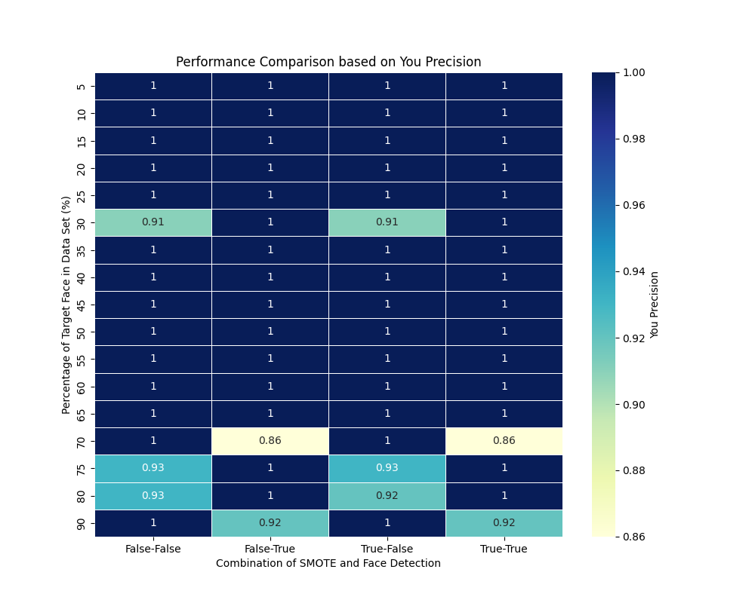
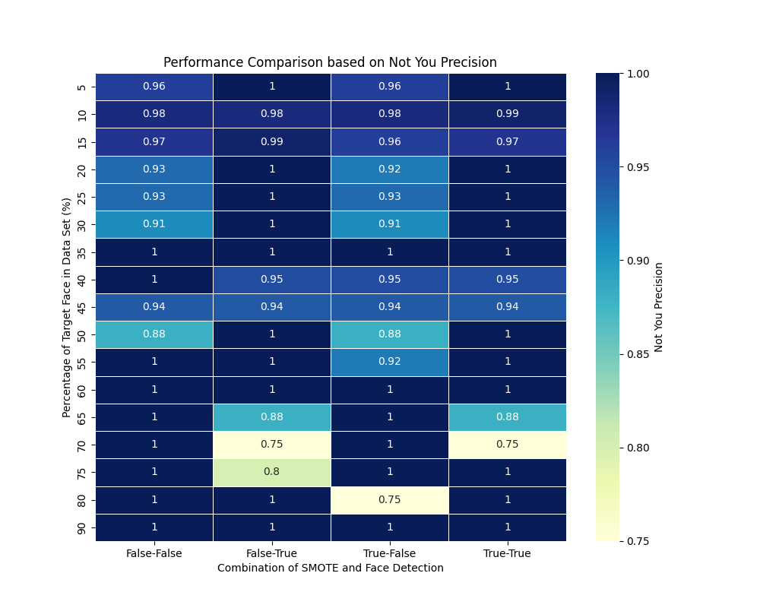
Results (Face Recognition)
Notes:
A False positive can be quite costly in some applications such as security verification. A bad actor could be granted access via this system on a false positive. A model that has a precision of 1 for all cases, produces no false positives.

Slide 15
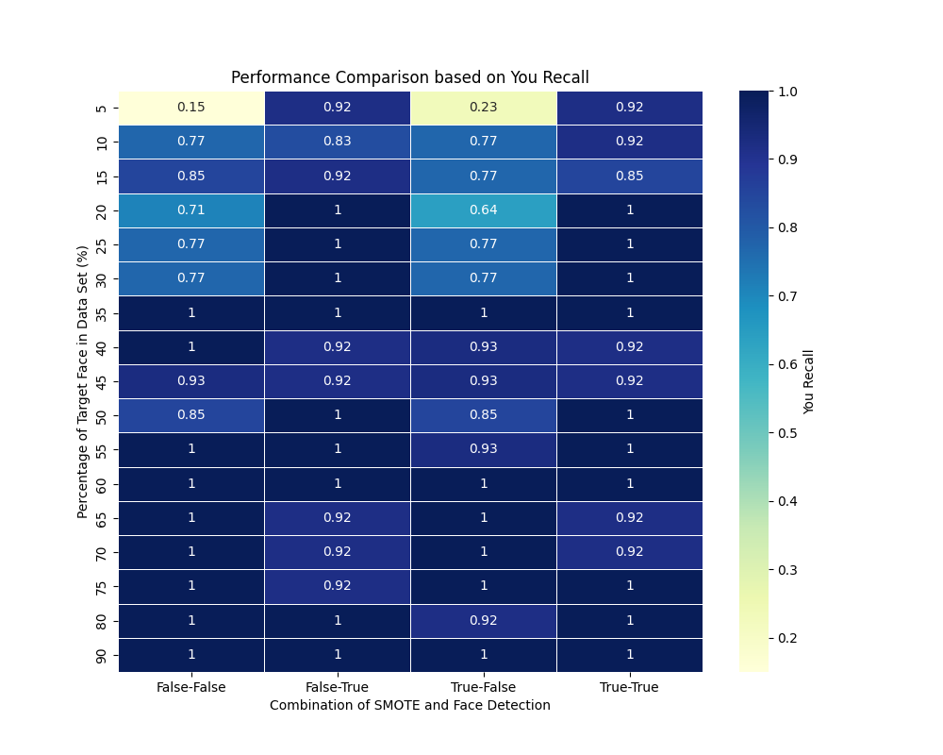
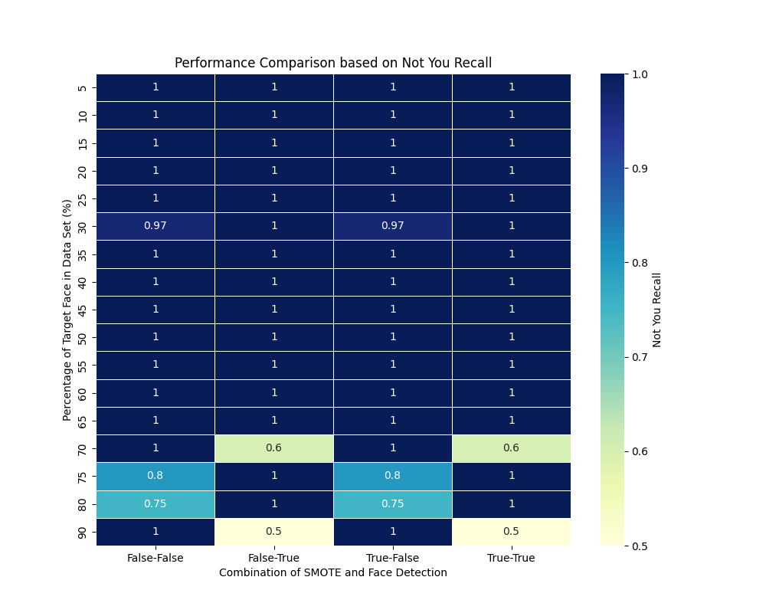
Results (Face Recognition)
Notes:
In contexts like security verification, a false negative implies that a legitimate user or entity, labeled as "You", is mistakenly denied access. In essence, if a model achieves a recall score of 1 across categories, it signifies that all genuine positive instances are correctly recognized by the system.

Slide 16
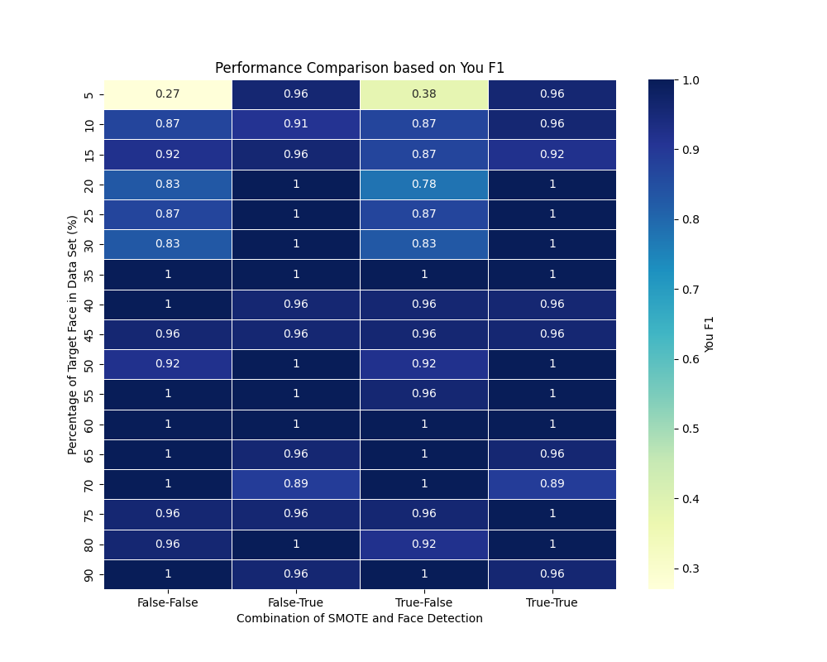
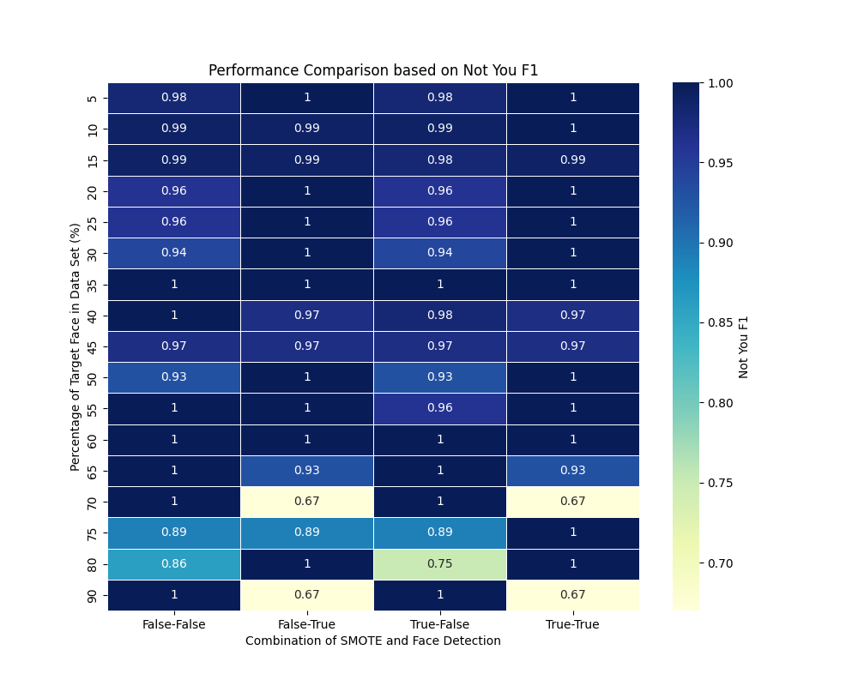
Results (Face Recognition)
Notes:
In facial recognition systems, the F1-score holds paramount importance as it strikes a balance between precision and recall, ensuring that both false positives and false negatives are minimized.

Slide 17
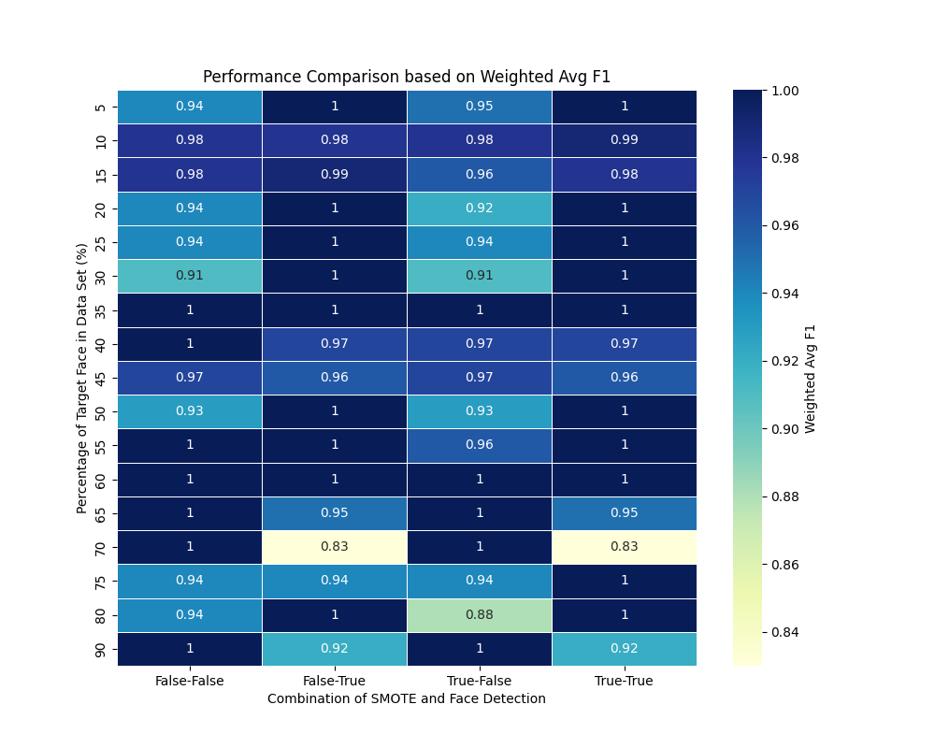
Results (Face Recognition)
Notes:
The weighted average F1-score is a pivotal metric in facial recognition systems, particularly when there are imbalances in class distributions. It provides a holistic view of a model's performance by calculating the F1-scores of each class proportionally, based on their presence in the dataset.

Slide 18
Future Work
Algorithmic Refinements
Diverse Datasets
Real-world Application Testing
Alternative Preprocessing Techniques
Security Measures

Slide 19
Conclusion
SMOTE’s impact is minimal
Face Detection is highly important
The system is robust against false positives in most cases
False negatives in the “you” case are more common, but not as costly or detrimental
Overall system performs well, and is trained quickly
Unseen cases not tested: i.e. I grow a beard every so often or wear sunglasses occasionally

